Slide 1


TEAM NAME: TEAM FORTIUS
PROBLEM STATEMENT TITLE:
MY CITY INFORMATION APP
LS2

Slide 2
PROBLEM STATEMENT
A mobile application which can give information about
Basic information about the place
Education institutes around
Hospitals
Police station
Hotels
Travel information

Slide 3
What the problem is?
Asked for such an software application which can give us the information about
City and it’s main attractions
Necessary amenities
Educational bodies
Travelling information

Slide 4
What this software does?
It gives the selected location of the client through geolocation or autocompletetextview inflated by scraping Indian cities provided on wikipedia after a succesful login.
On asking this application also provides the client with the basic information that are necessary such as travel information ,hospitals and other basic amenities either of the selected location.

Slide 5
Why this software application?
Provides a common platform to all the various application ,making it completely handy as you have to no more be tangled between various applications.
User has the privilege to add any utility he desires to and also is allowed to rate the hospitality of the services
Designed according to the current developments like providing voice communication,verifying user and a few more.

Slide 6
Technologies used
Android studio
Compiling and building the app
Geocoding
Get latitude,longitude and address of location through gps
Volley
Internet loading library to minimize usage of LoaderManager

Slide 7
4) Glide
Image loading library due to low heapSize of android
5) Jsoup
HTML Web Parsing used to get city’s main Attractions.
6) Picasso
Image loading library due to low heap Size of android
7) Google maps and play Services:
Getting MapView and other options provided by Google Play Services

Slide 8
8) Github
Version Control System to simplify collaborative work .
9) Fire base
To get real time secured data from google servers using OAuth .
10) Lottie animation
For the animation of the application .

Slide 9

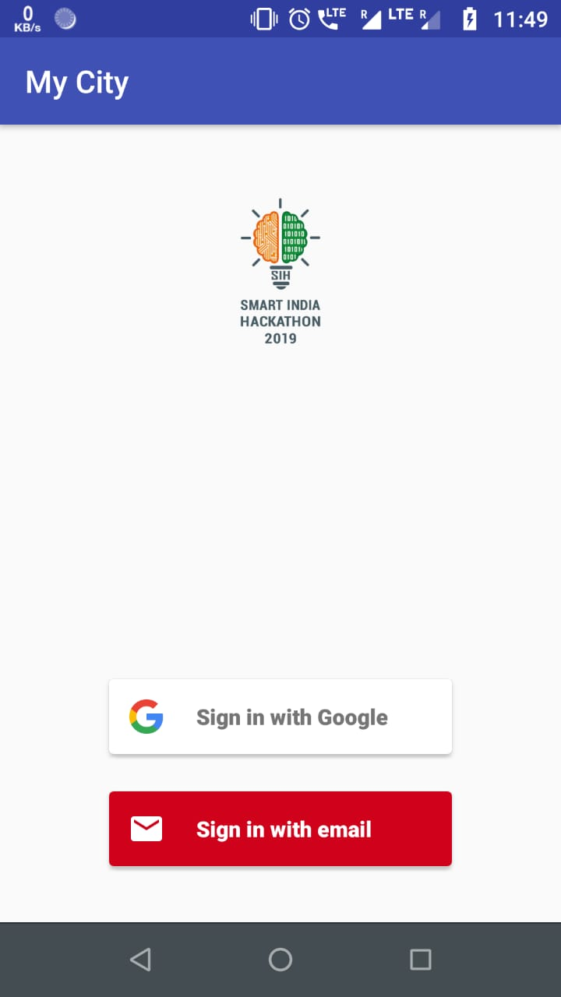
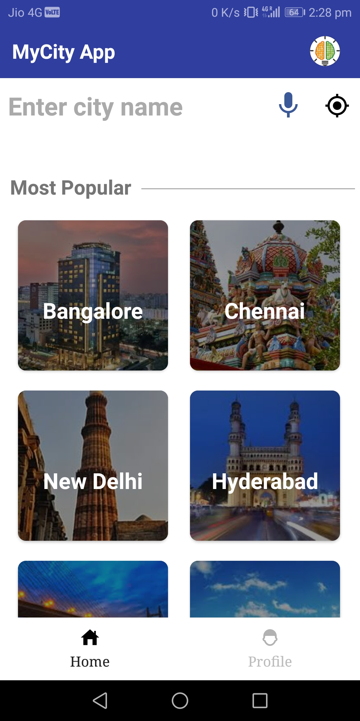
On
logging in

Slide 10
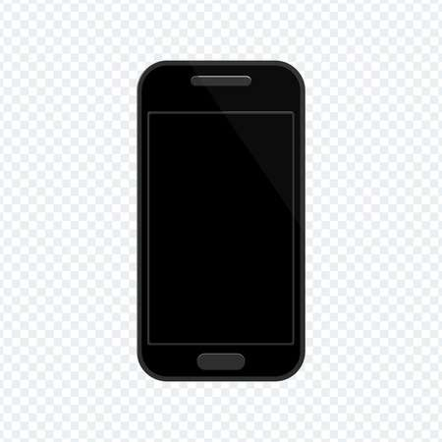
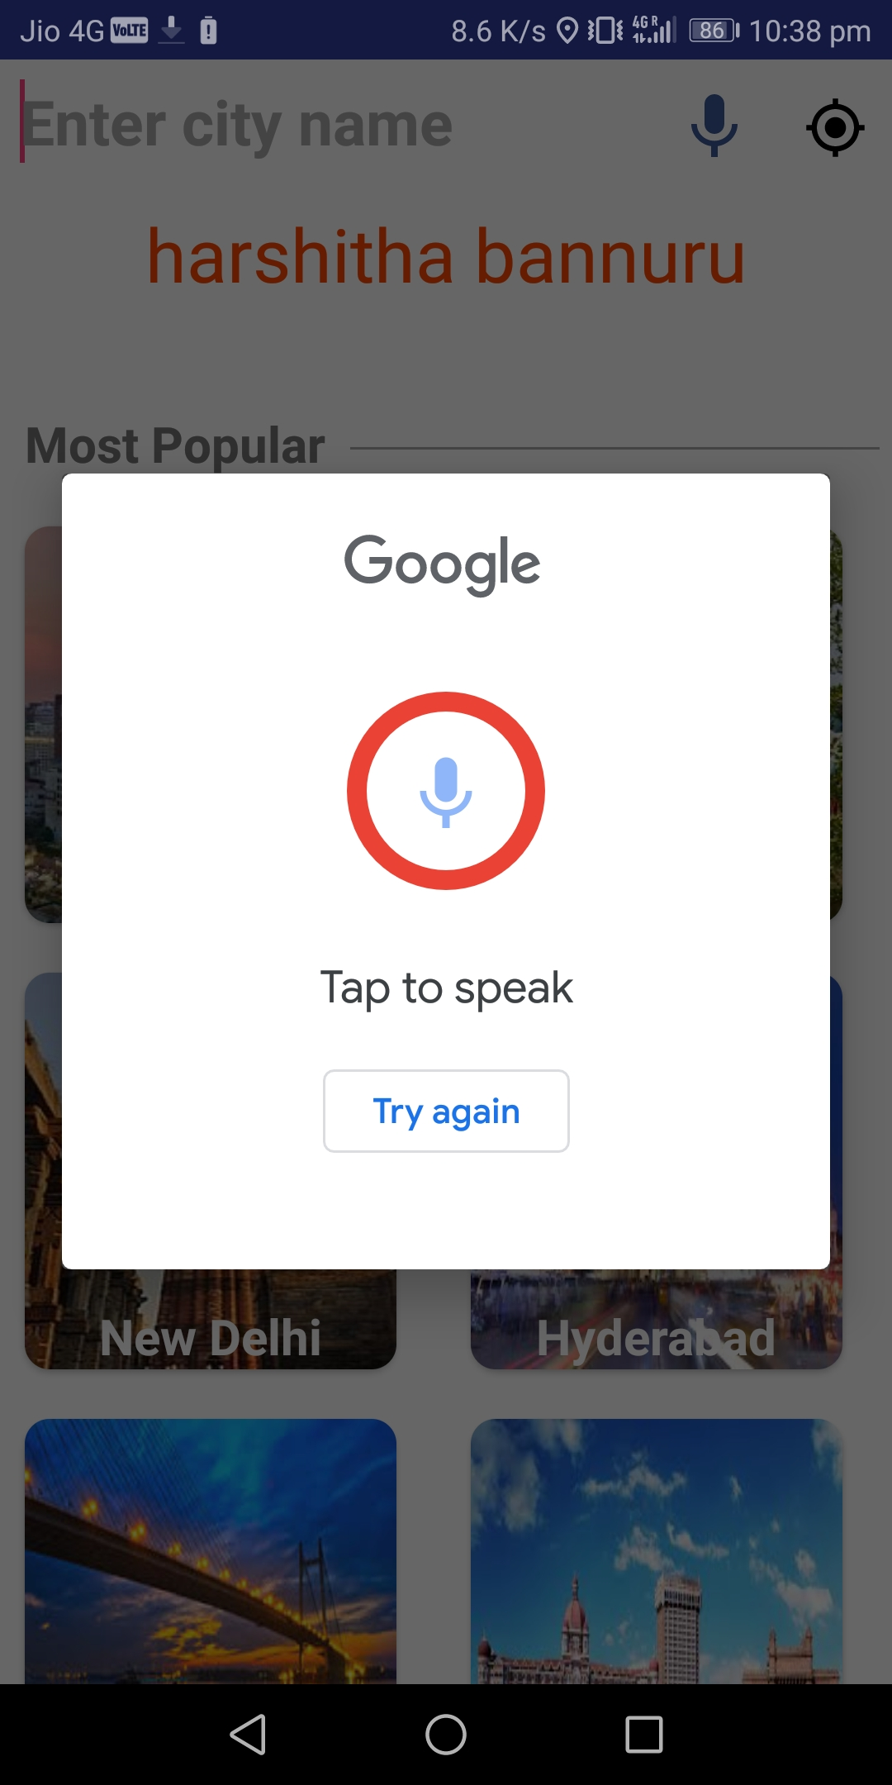
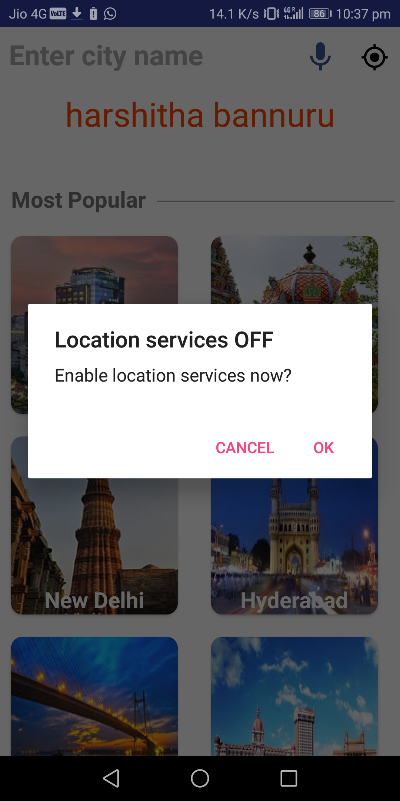
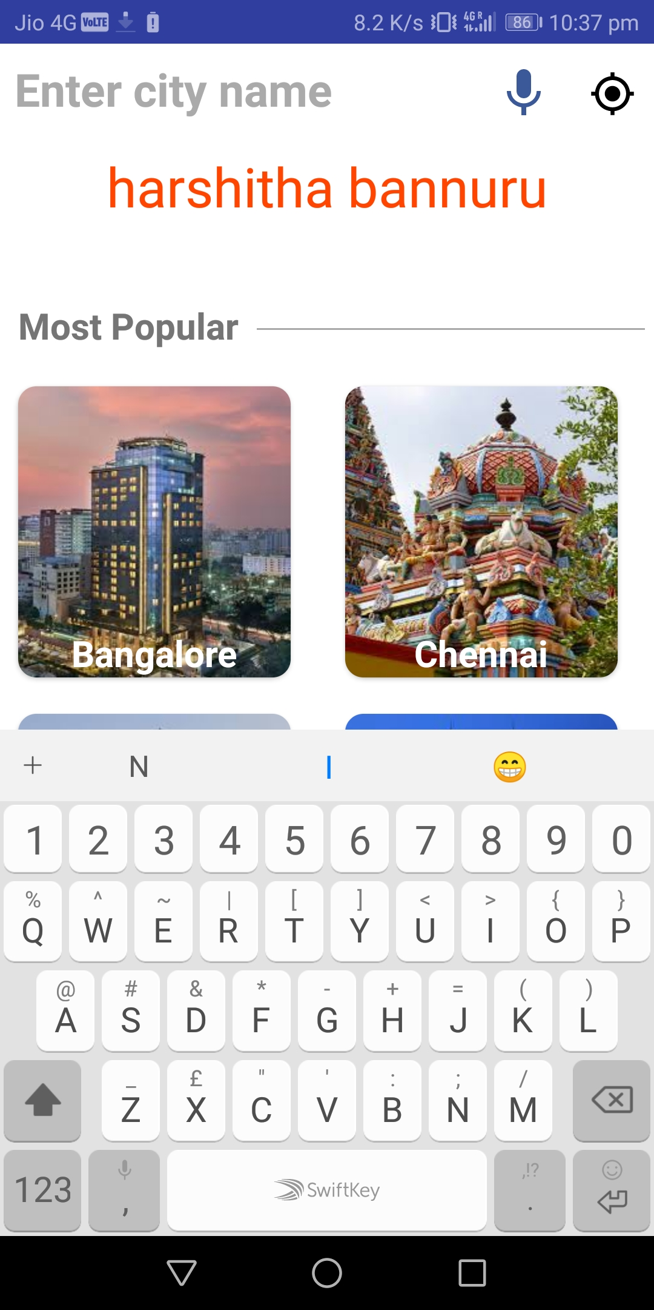
Sound
navigation
GPS
navigation
Keyboard
navigation

Slide 11
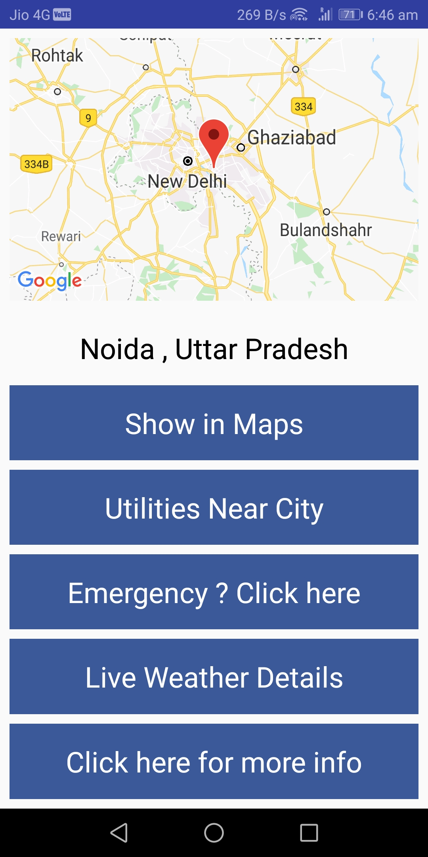
On clicking GO

Slide 12
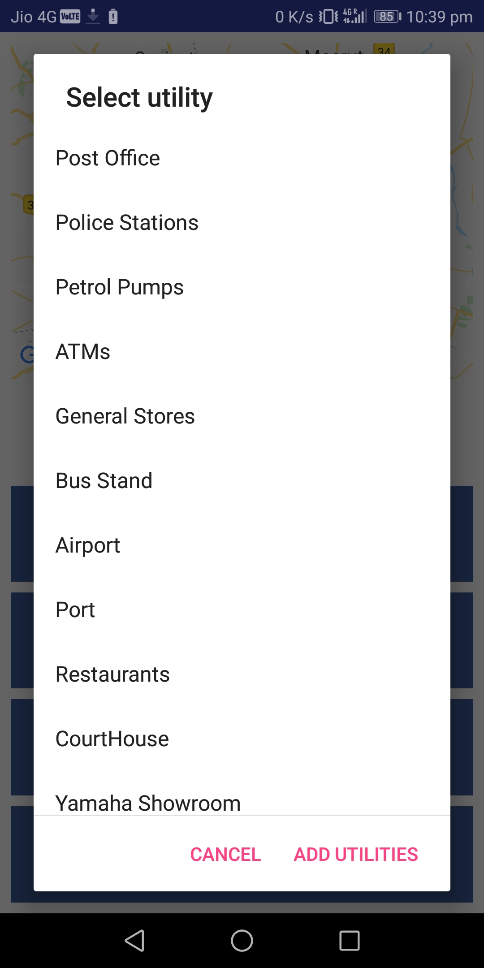
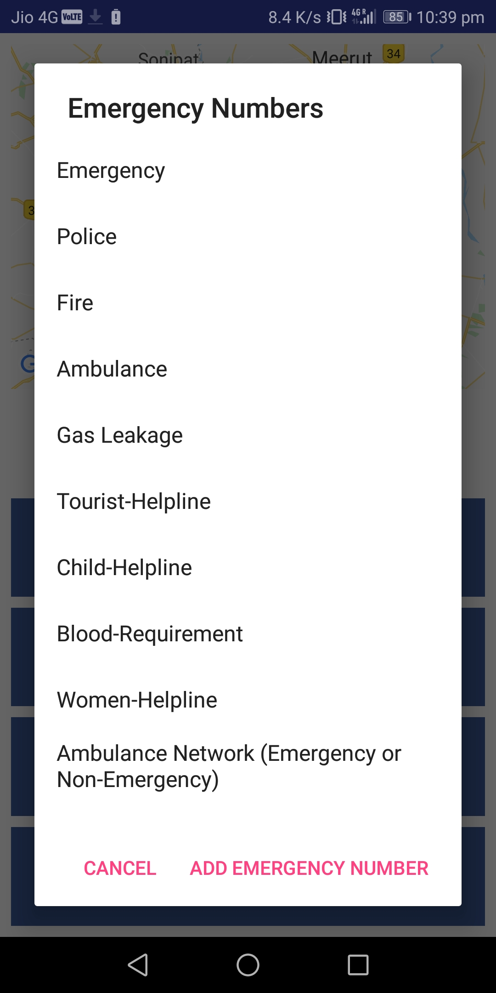
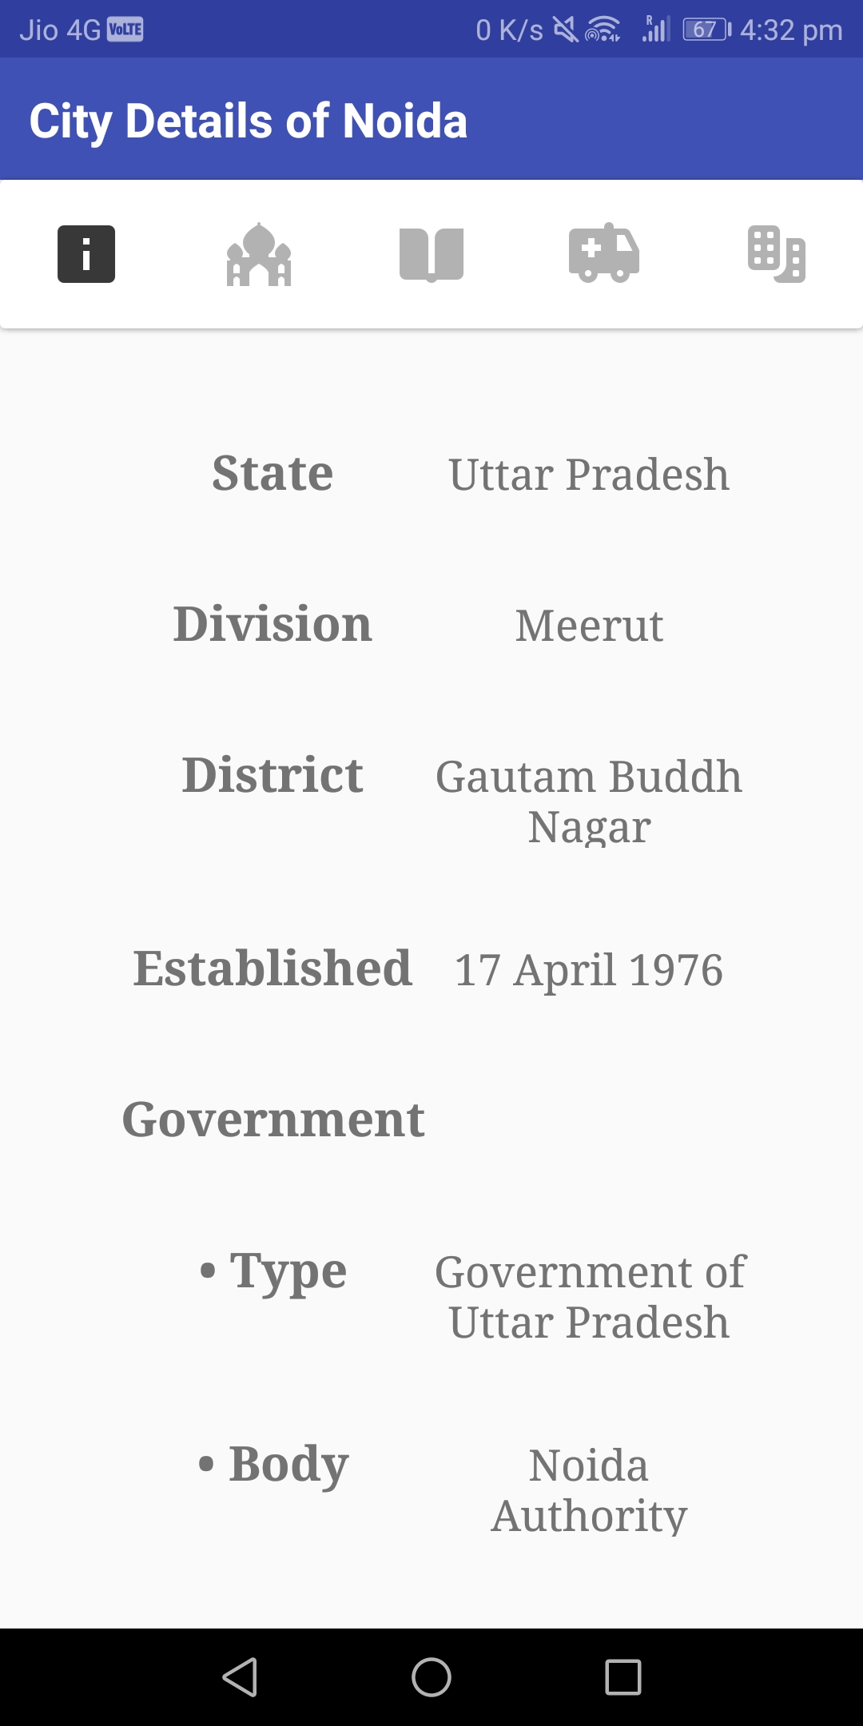
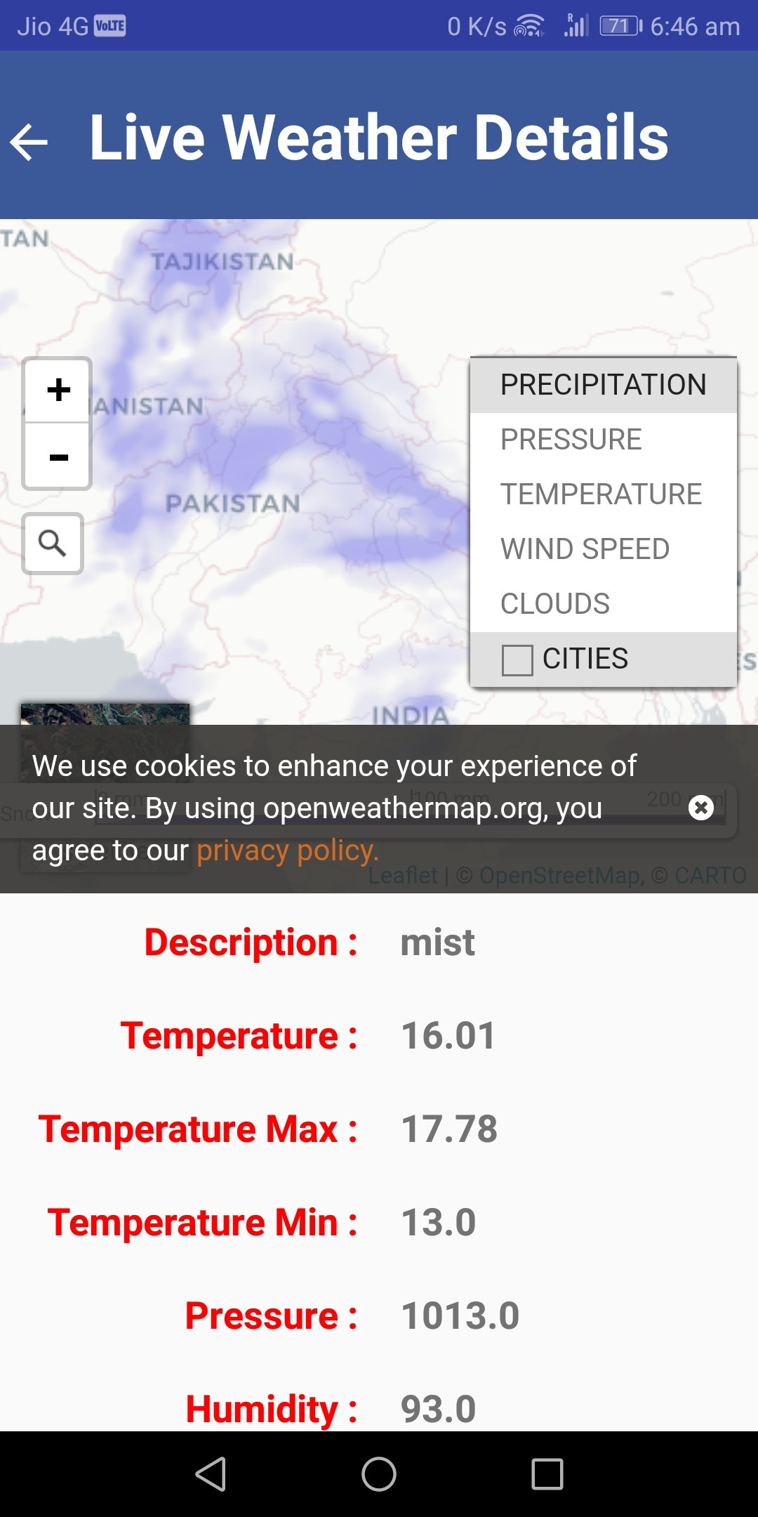
Complete map view
Emergency? Click here
Weather details
Utilities near city
Click here for info

Slide 13
Features of the application
2) Emergency contacts accordingly for client into the bargain with primary contacts
Utilities accordingly for the client into the bargain with primary utilities
3)Weather report of the desired location

Slide 14
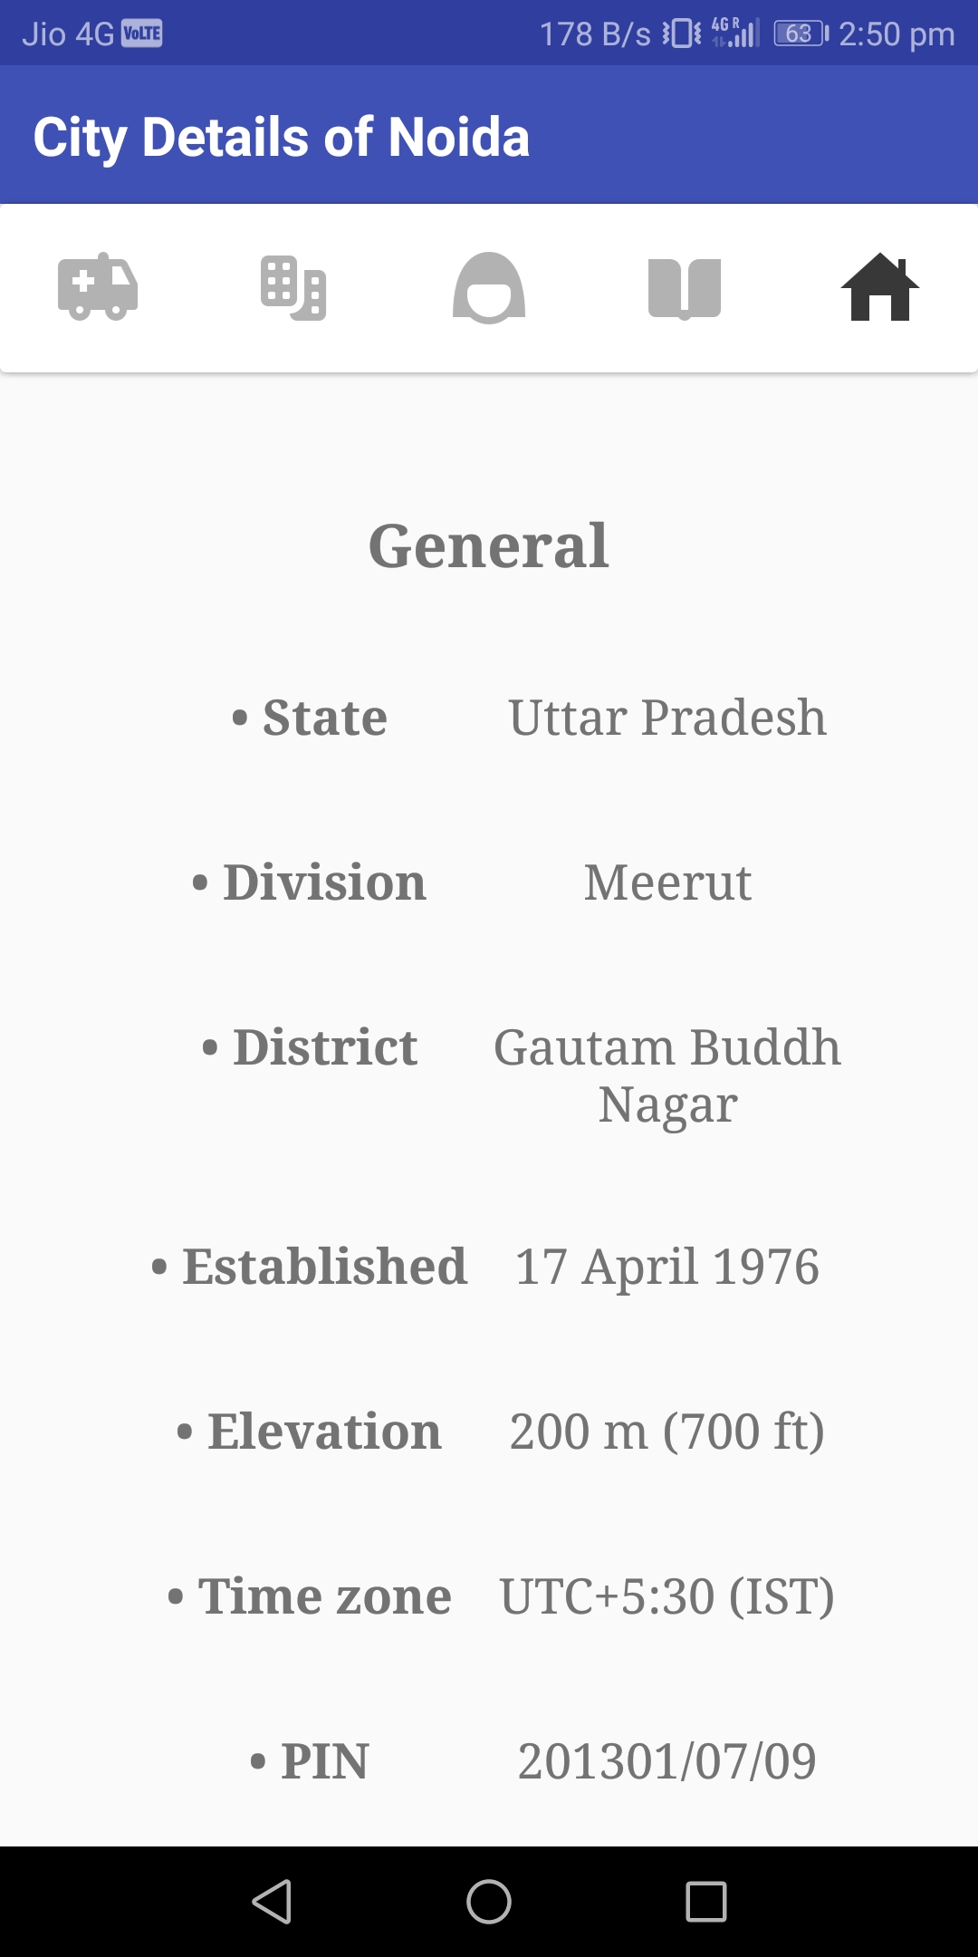
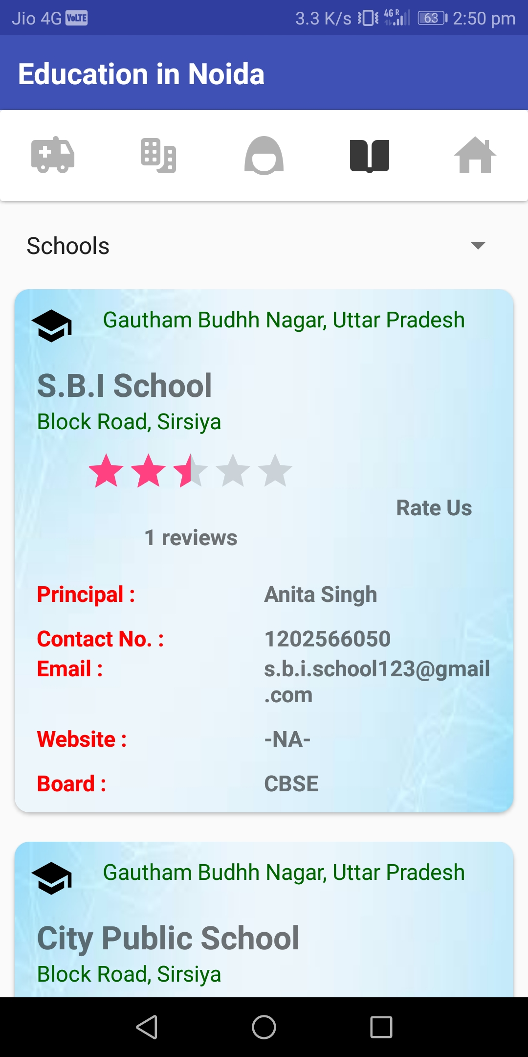
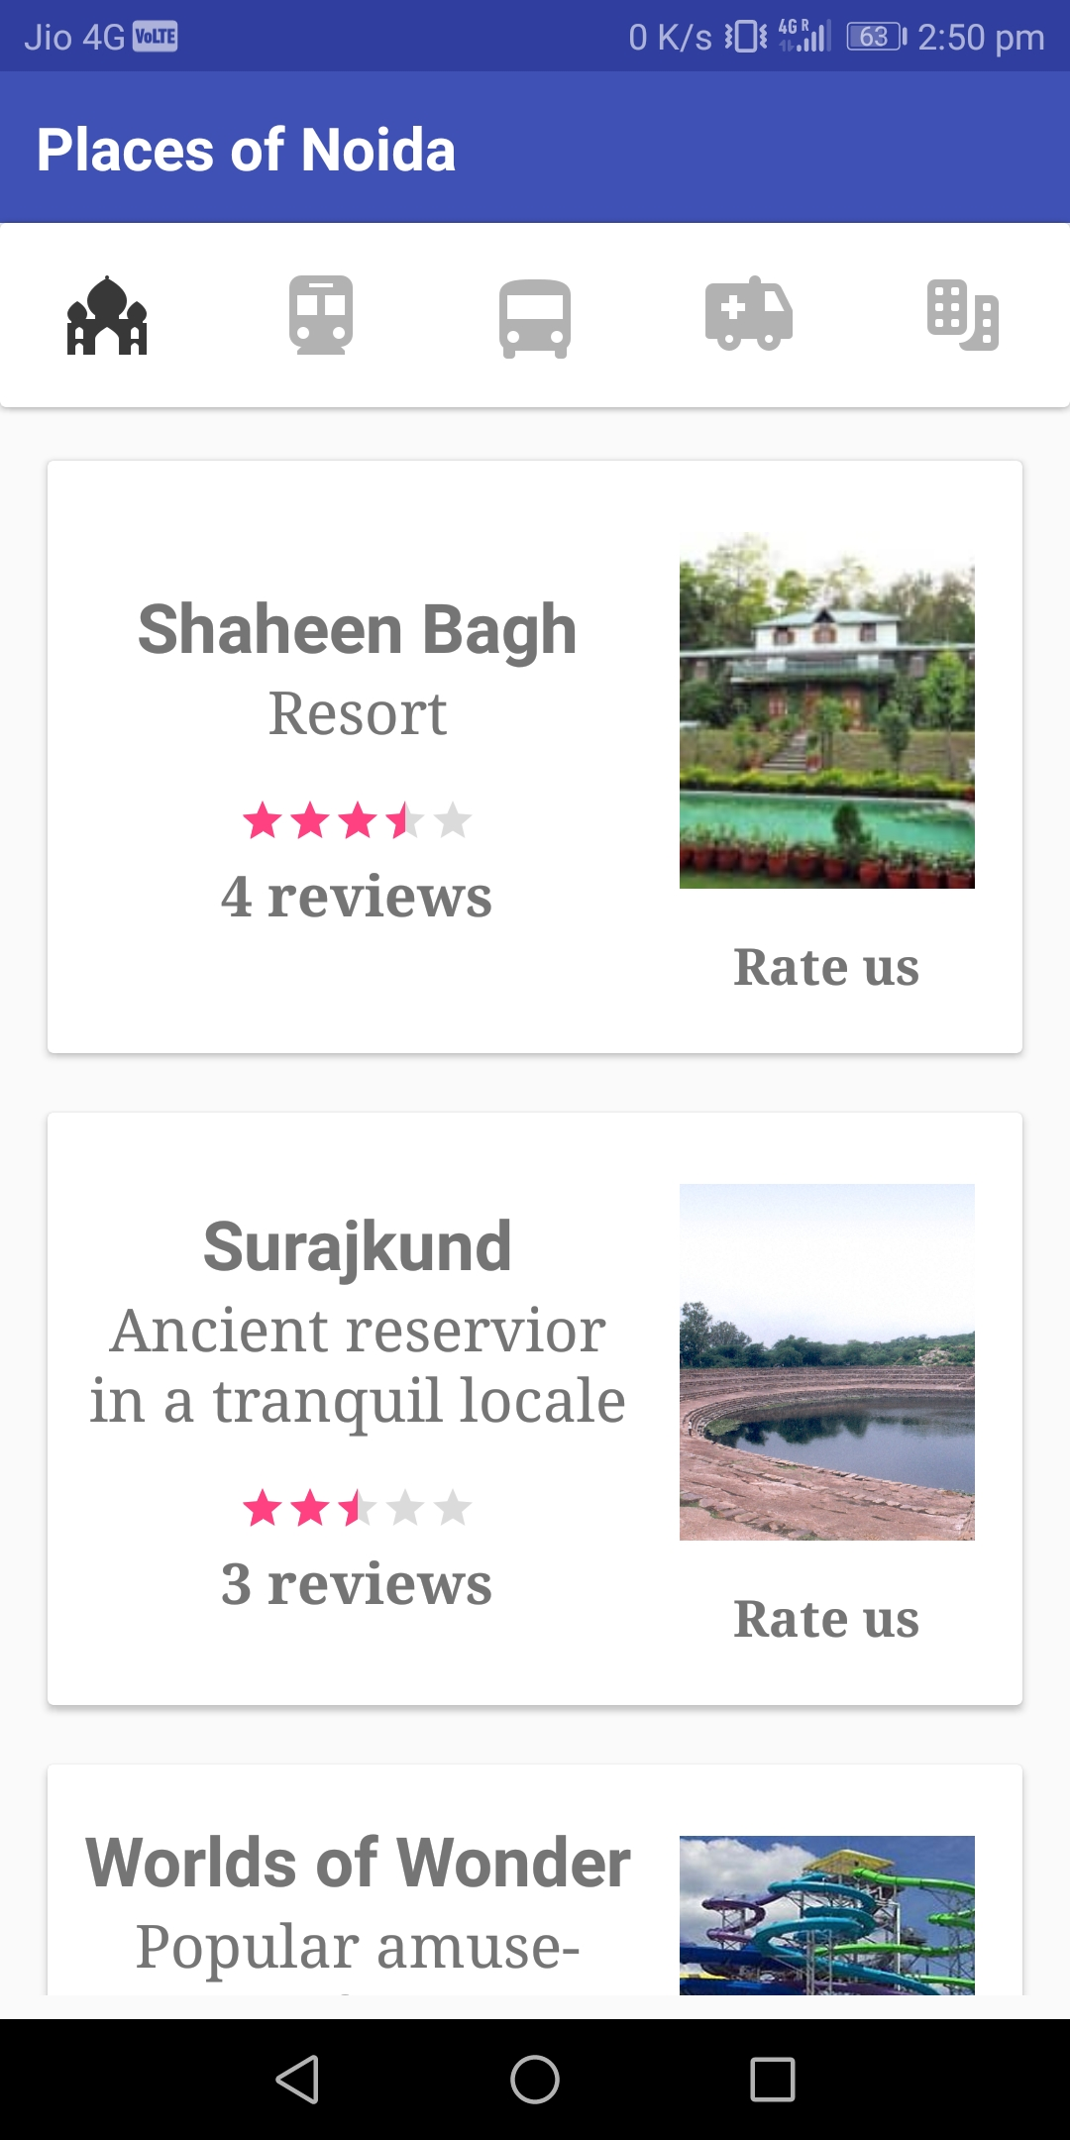
5)Main attractions
4)Basic information of the place
6)Educational bodies

Slide 15
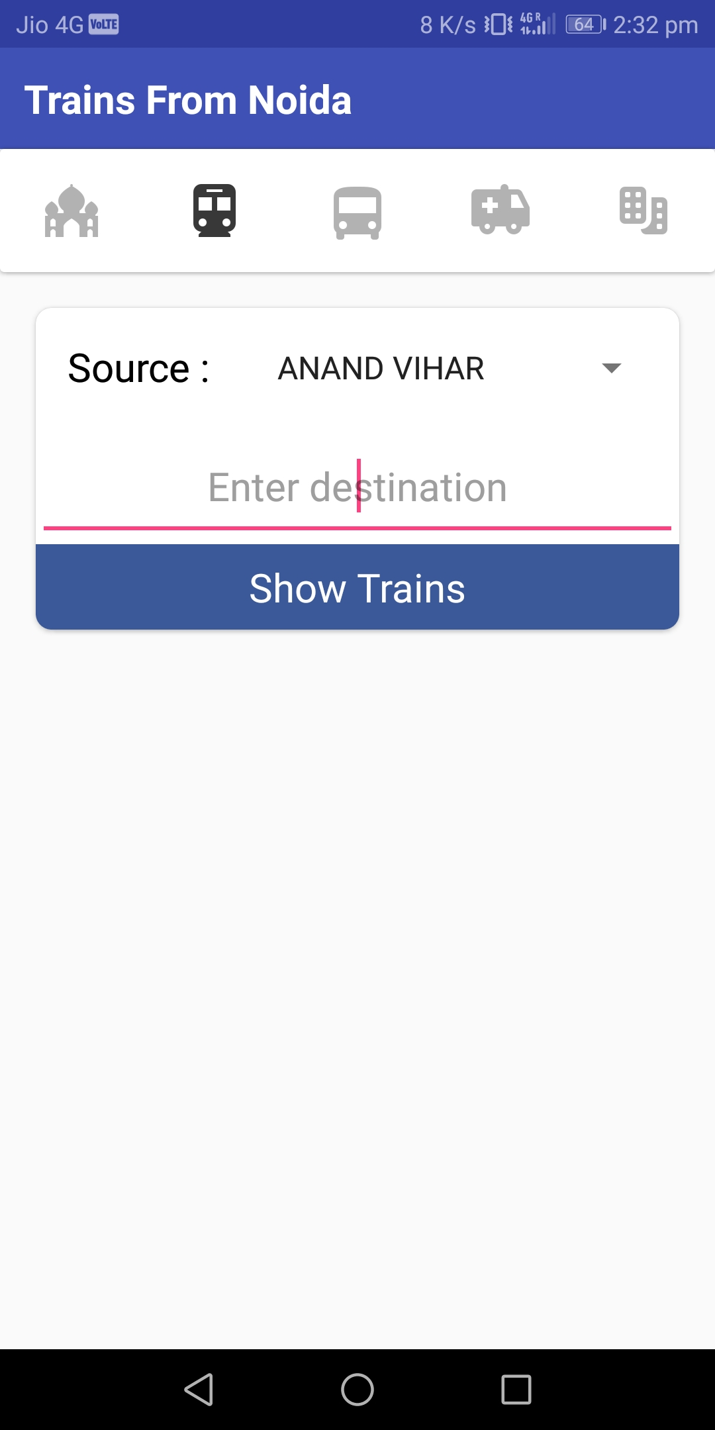
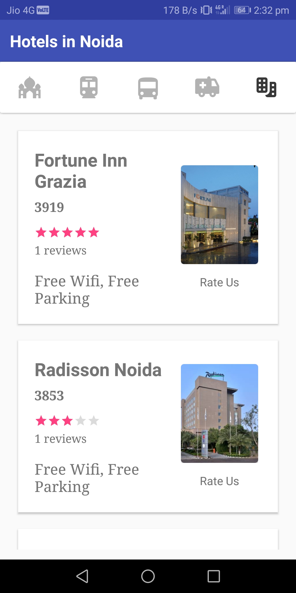
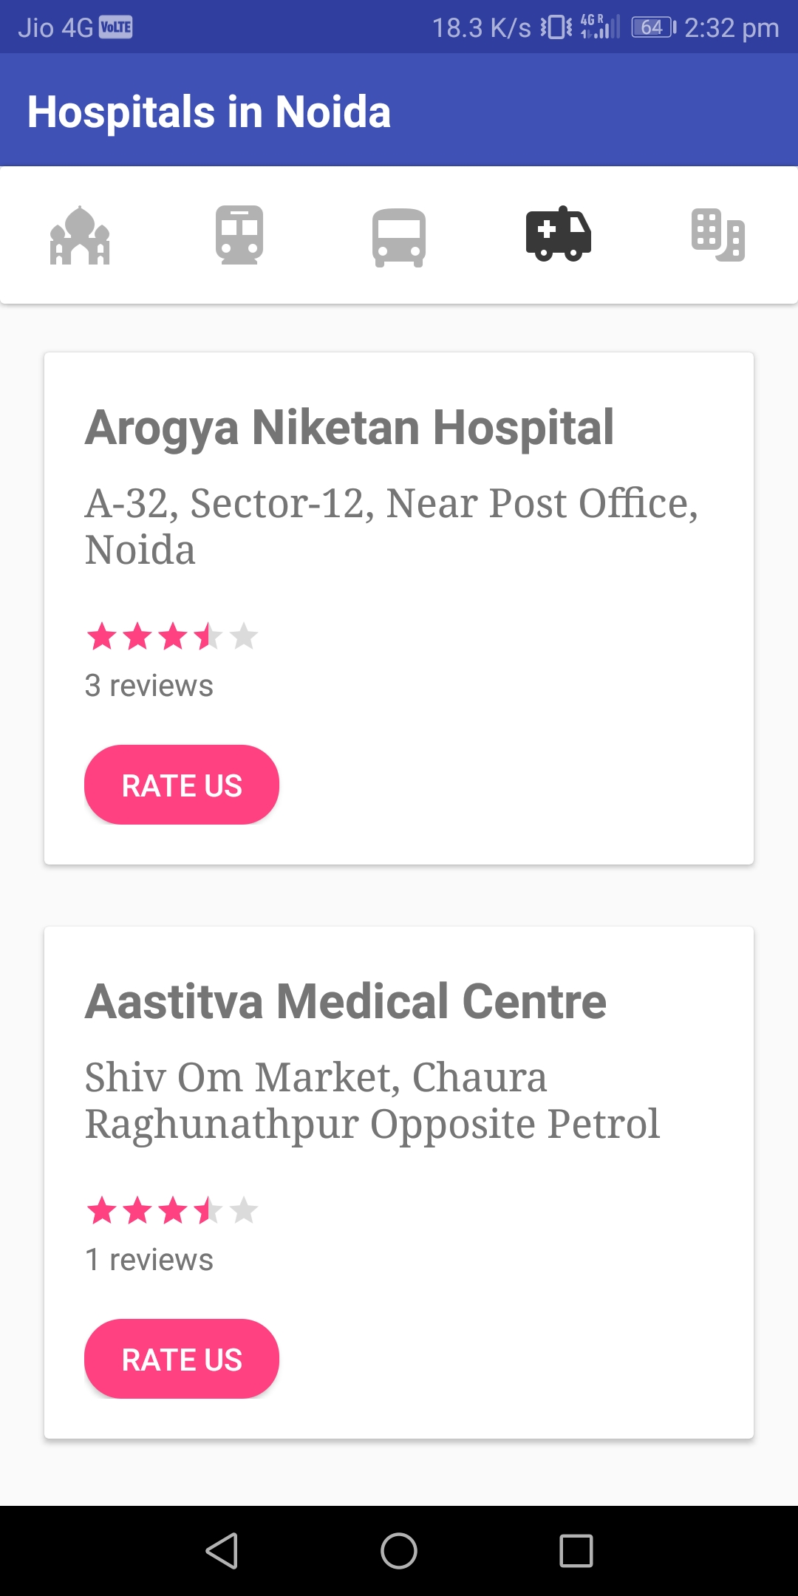
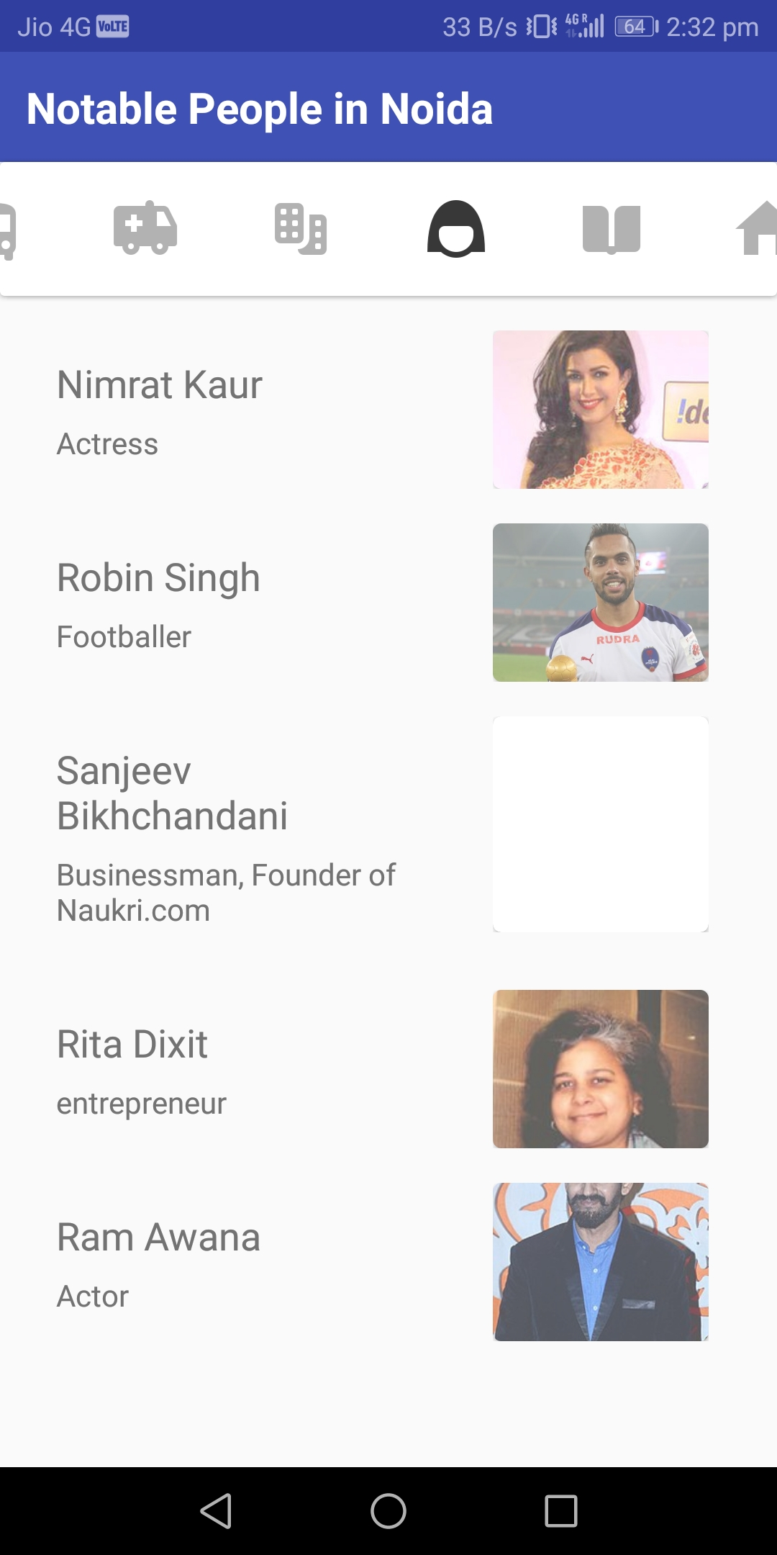
8)Hospitals
9) Notable people
10)Travel information
7)Resorts and Hotels

